Slide 1
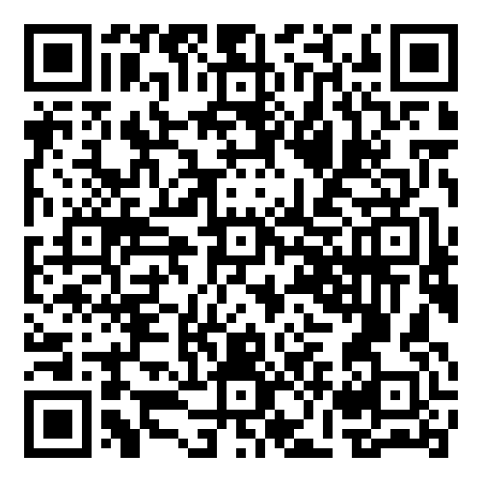
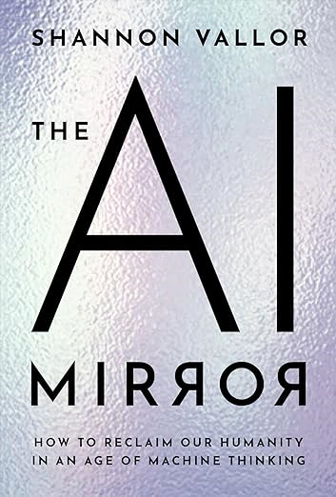
New Science Book Information from UNIV. CO-OP
ＡＩの鏡:
機械思考の時代にいかに人間性を取り戻すか
The AI Mirror :
How to Reclaim Our Humanity in an Age of Machine Thinking
※大学生協洋書オンラインストアの該当商品のページへ
2024年6月
刊行予定
For many, new technology represents hope for the future--the promise of shared human flourishing and collective liberation from drudgery that defines the "good life," but always seems to elude our species. Artificial intelligence (AI) technology sparks this hope in a particular way. It promises a future in which the frailties of the human mind, body, and will that continually frustrate these utopian dreams are finally overcome--not by us, but by our machines. Today's technology betrays this hope. It is forged from human-generated data into immensely powerful but flawed mirrors that endlessly reflect the same errors, biases, and failures of wisdom we are striving to escape. Our new digital mirrors point backward. They reflect only where our data show that humanity has already been, never where we might venture together for the first time. To open new futures for ourselves with these tools is as misguided as gazing into a mirror while trying to climb an uncharted mountain. We have reached a crucial juncture not just in AI development but in human history. We confront existential challenges, not least of which is the fate of our planet itself. To meet this moment, we need something new from AI, and more importantly, from ourselves. We need to find new hope-not to surrender our greatest moral and intellectual ambitions to machines that have none, but to renew those ambitions, collectively, for ourselves. Shannon Vallor makes a wide-ranging, prophetic, and philosophical case for what AI could be. She calls us to reclaim our human potential for moral and intellectual growth, rather than losing sight of our shared humanity as we gaze dully into our AI mirrors. Rather than forecasting a dark future, she encourages us to pursue truly humane technology that helps us to realize our potential at last. This is the only way we can break the cycle of abandoning our responsibilities to future generations by continually replicating our past. Along the way, Vallor illuminates the inn
●著者Vallor, Shannon
●出版社： Oxford University Press, New York
●ISBN：978-0-19-775906-6
●刊行：2024年6月
● hardcover/208P.
組合員価格は生協店舗にお尋ねください
＊海外からの仕入れのため為替レートの変動により価格は変動します。
研究費・科研費でのご購入は生協が便利で安心！
注文書
ＡＩの鏡: 機械思考の時代にいかに人間性を取り戻すか/ The AI Mirror :How to Reclaim Our Humanity in an Age of Machine Thinking
ご注文 冊
氏名: TEL: お支払方法（○で囲む） 校費・私費
学部名； 学科名： 研究科or研究室名：
大学生協洋書オンラインストア
発行：2024年5月23日
https://yosho.univcoop.jp/BookShop/

